Slide 1

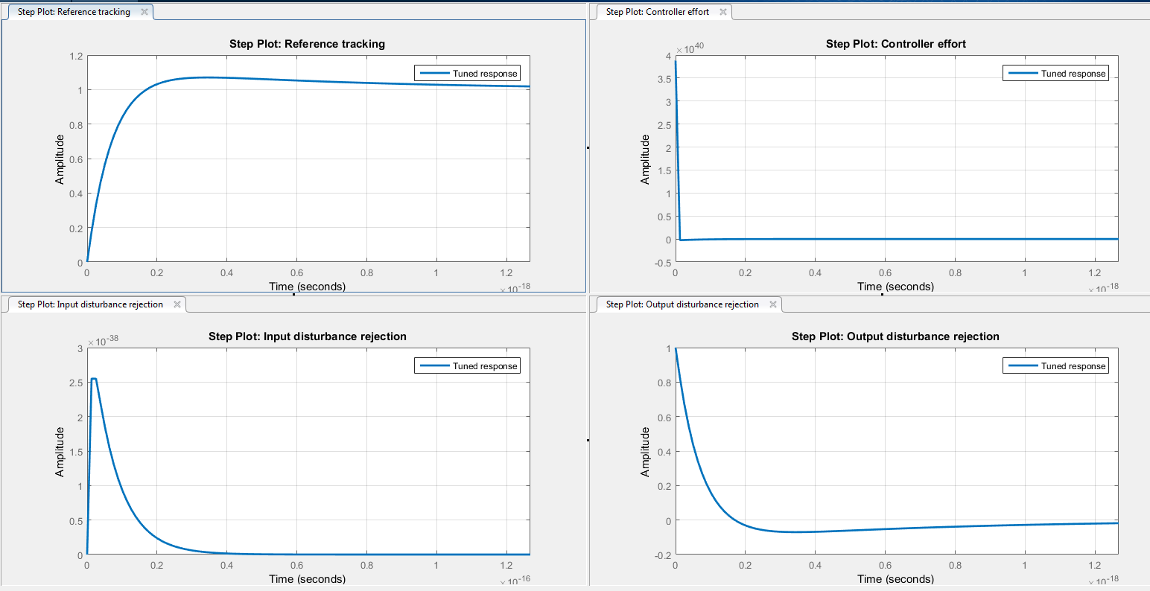
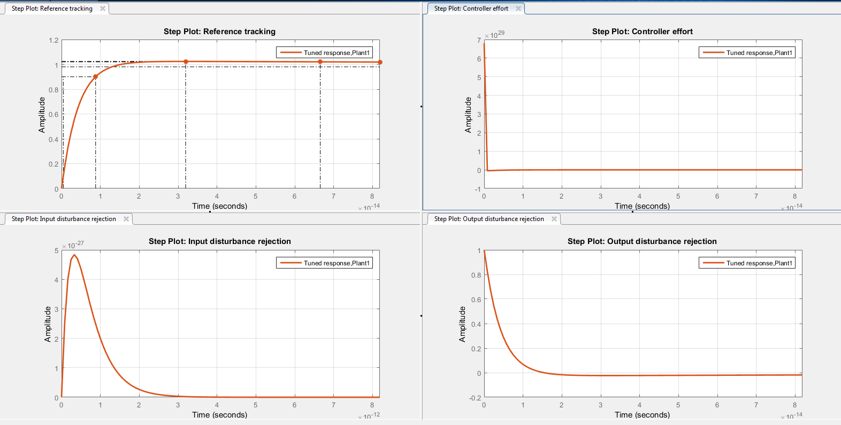
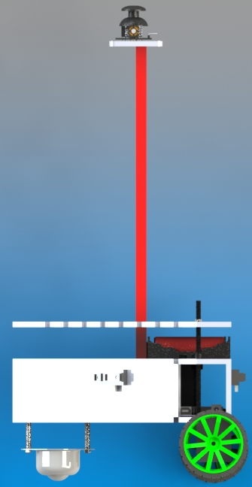
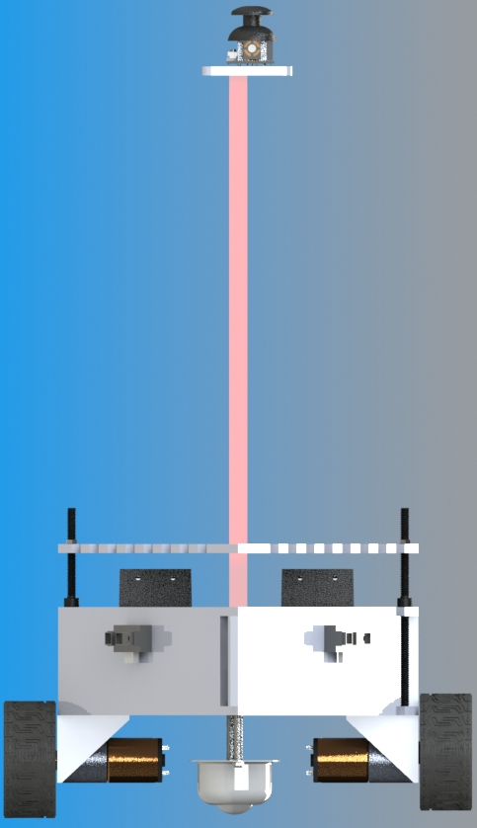
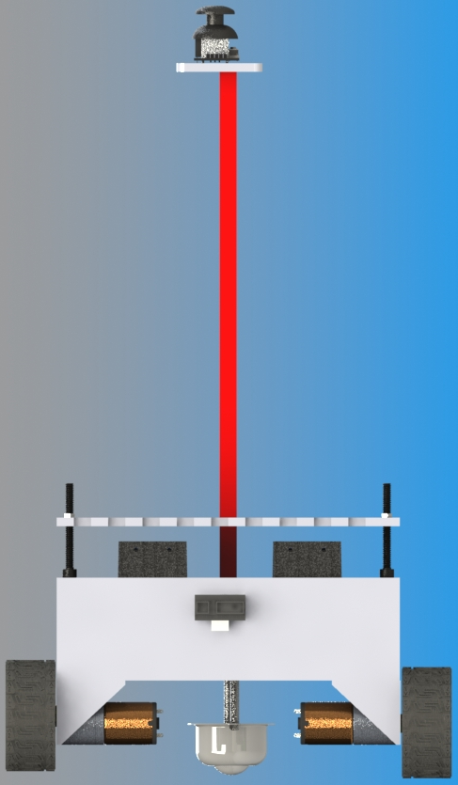
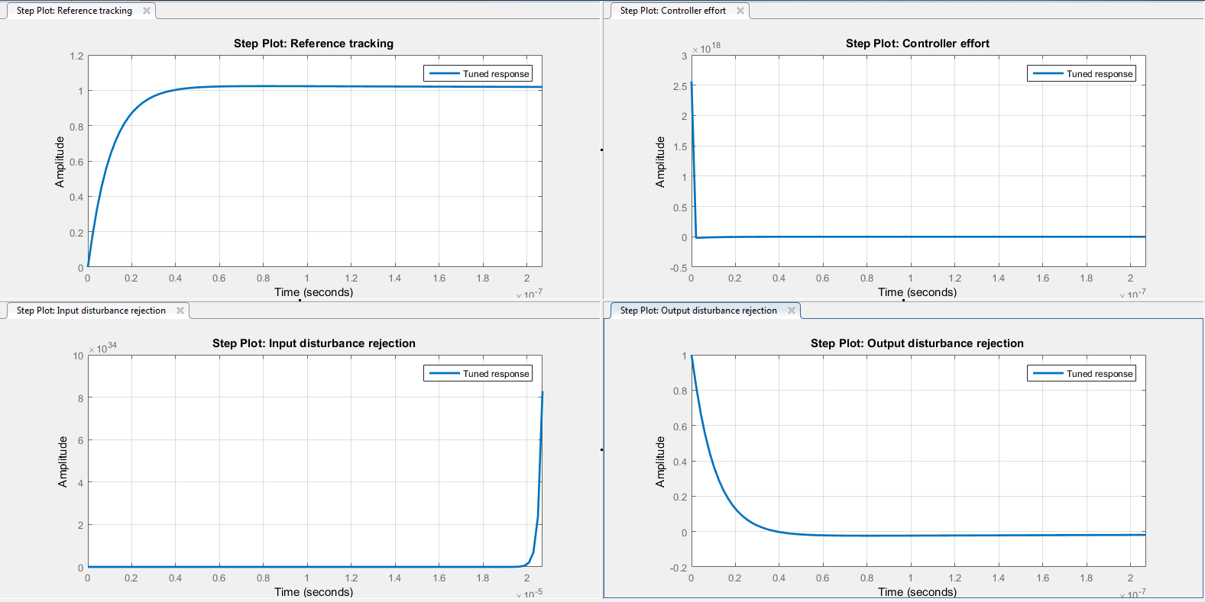
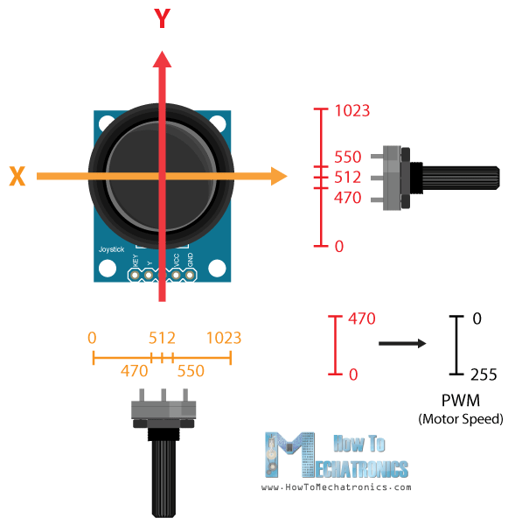
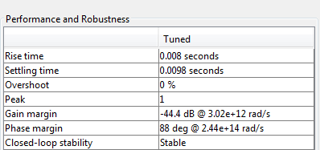
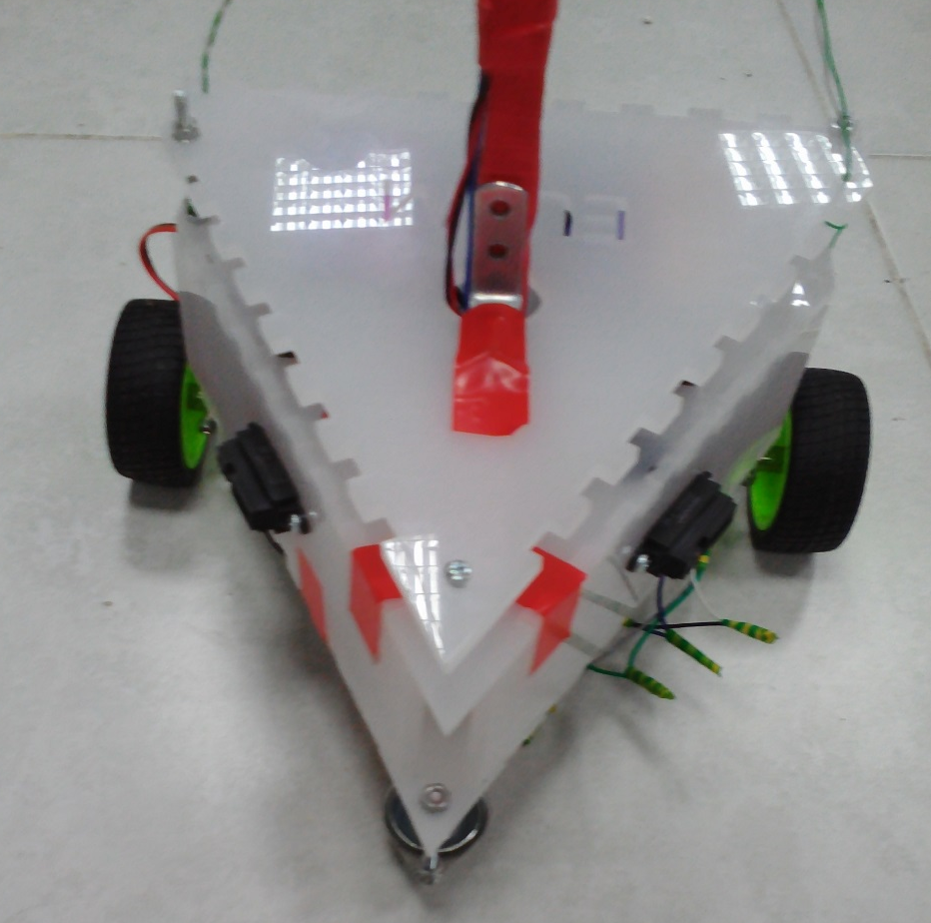
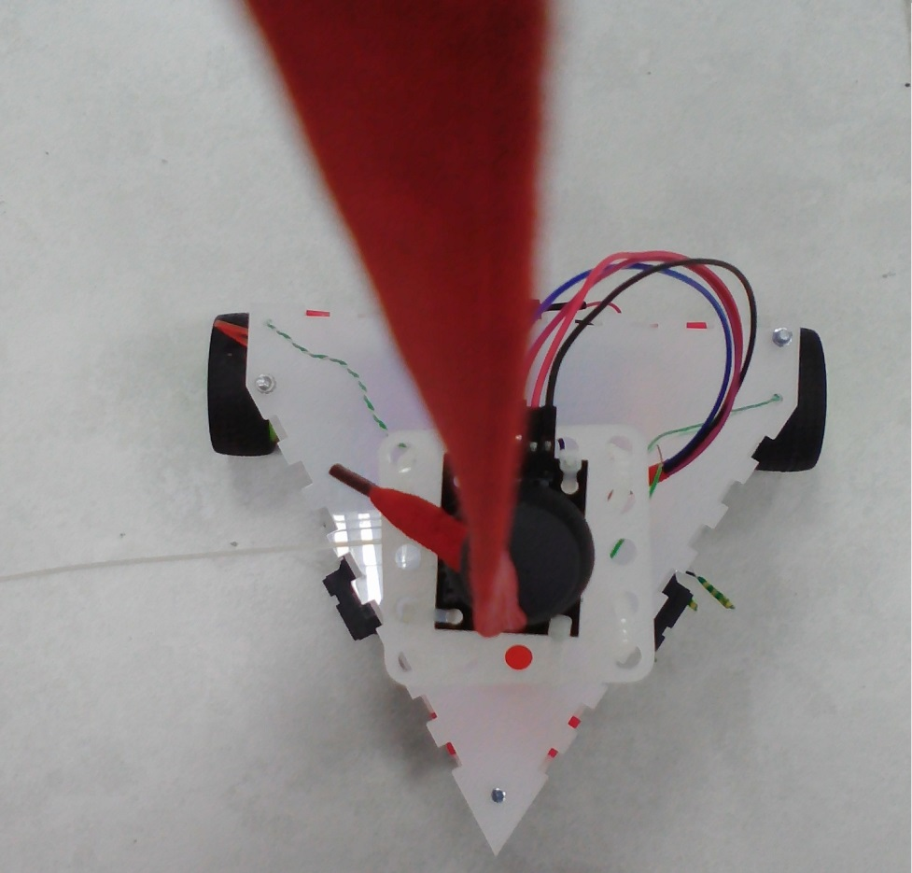
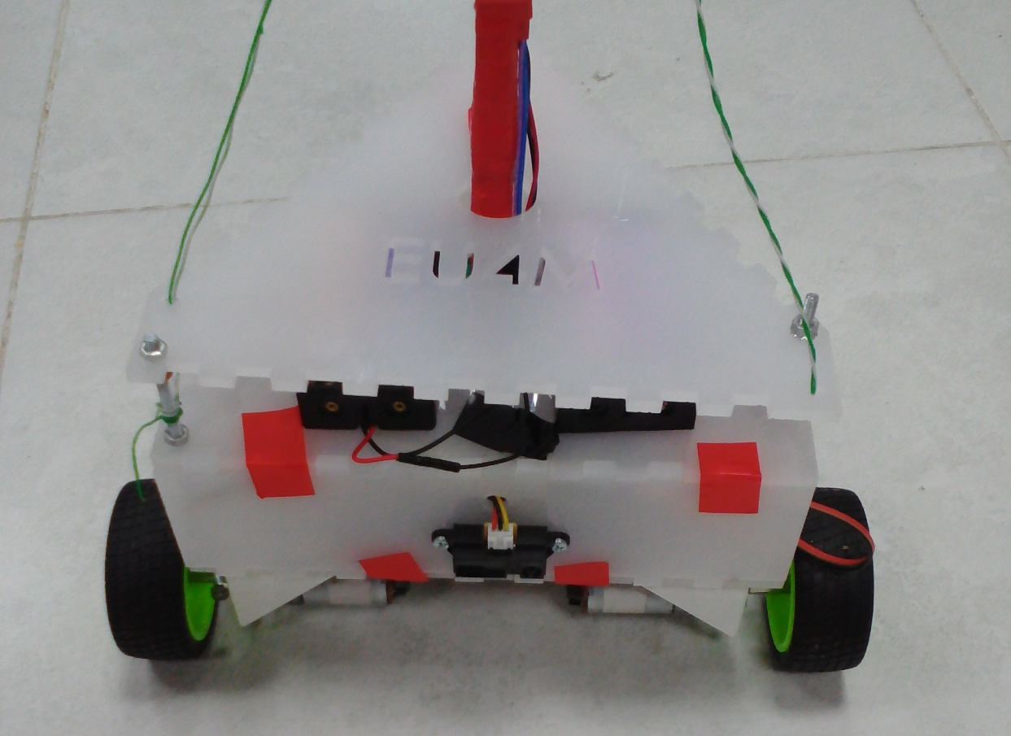

Design & Implementation of Robotic Infusion Stand.
Team Members:
Berit Adina Haendel , Mohd Saiful Akmal Bin Razali, Gabriel de Brito Silva, Hedaya Ali
B.adina@nu.edu.eg M.saiful@nu.edu.eg g.silva@nu.edu.eg h.raafat@nu.edu.eg
Supervised by
Dr. Ahmad Taher Azar , Hossam Hassan ahmad_t_azar @ieee.org Hhassan@nu.edu.eg
Introduction & Motivation
Infusion Stand is one of the medical supportive tools that not only used extensively in hospitals, clinics, physical practices but also in the supportive care provided in the home.
Robotic Infusion Stand is an improved version of existing Infusion Stand whereby it will moving with an input given due to the new elongation of the patient, which influence by the strip reaction .
Mobilization of Infusion Stand from a place to another place is necessary not only for the patients itself but also for the nurses.
we come out with a proposal to design and implement a keeping distance mechanism on the Infusion Stand.
The overall design of this Robotic Infusion Stand consists of 2 layers of base, wheels, a stand with a joystick. In order to maximize the availability of the space, we installed the Arduino Mega, L298N H bridge, breadboard on upper side of the first base. Below side of the first base is attached with a L-shape motor hubs, motors, 65mm wheels & caster ball wheel. On the second base, we installed fours 3.5V Li-Ion batteries to make sure that the center of mass is located above the pivot point. Then, a stand is placed on the first base connected through the second base with a hole in the middle of the base itself. Joystick is placed on the highest point of the Robotic Infusion Stand itself which is on the stand with a strip attached to the joystick.
methods
Control concept
Physical System
Robot moves to new position and the strip reaction influences the new elongation of the joystick.
X
Controller 2
rotation
vLsp
Subsystem:
Motor Left
Speed Control
vLcurr
X
+
+
-1
vRsp
Subsystem:
Motor Right
Speed Control
Y
Controller 1
translation
+
vRcurr
Y
Figure 3: Hardware Design (iii). (a) Front View. (b) Side View. (c) Back View
+
EXPERIMENTAL RESULTS
Figure 1. Evolvement of Automation control systems
In summary, various controllers were used to tune angles servos ranging to get the best performance and stability. The graphs in fig5 presents best results tuned using the FAST PID (PIDF) controller
PIDF controller has been tuned to favor reference tracking, controller effort, input disturbance rejection and output disturbance rejection.
Table 1 presents our desired specifications for the system. The controllers are tuned in such away that they fall within the limits of set specification for rise time, settling time, overshoot and peak.
Figure 5 shows the result obtained. From the graph results, one ca conclude that we have no overshoots in any of the cases, our rise and settling times are all acceptable.
Abbreviations:
vLsp/vRsp = setpoint speed for motor left/right
vLcurr/vRcurr = current motor speed left/right determined by encoder
verrL = error of motor speed left (vLsp-vLcurr)
Figure 5. Tune response graphs for the PIDF robust controllers
Concept of Joystick
Conclusion & Future Work
Joystick is theoretically made up of two potentiometers which are connected to the analog inputs of the microcontroller (Arduino Mega). This joystick will have values from 0 to 1023.
Value of the joystick on both axes (x-axis & y-axis) is 512 when the joystick stays in the Centre position.
Conclusions
A brief explanation of forward and inverse kinematics of 5 DOF Robotic arm is presented.
The mathematical model is prepared and solved for positioning and orienting the end effectors. The controller of the system shows good performances behavior.
The geometric algorithm developed was implemented successfully, and presents the best solution for embedded systems with limited resources.
Future Work
Using stepper motors to carry more load.
Implementation of dynamic torque with joint feed back control method.
Add a vision sytem for colors and objects detection.
Integrate a 3D camera like Kinect to dynamically interact with its envirenment.
Table 1. Performance and Robustness specifications for system
Our design :
Acknowledgements
Figure 4. DOF Robot Arm Prototype
Special thanks to the course instructor Dr Ahmad Taher Azar for his valuable effort during the course and for his guidelines to prepare this project.
Figure 2: Implemented Design (iii). (a) Front View. (b) Top View. (c) Back View

